Slide 1
Products for Every Type of Building
PRODUCT PRESENTATION

Slide 2
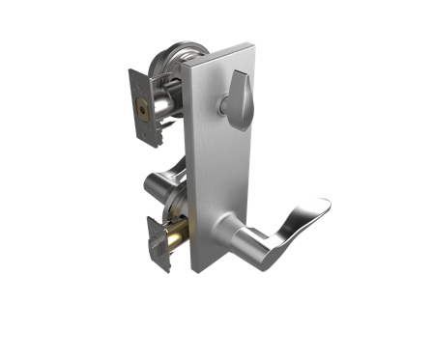
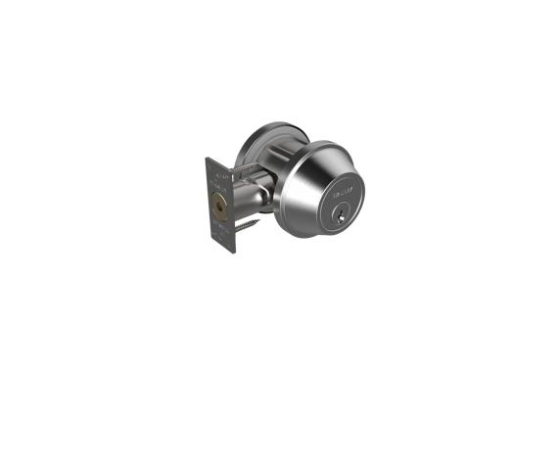
STANLEY: An Enduring Legacy
Frederick T. Stanley’s vision was to create a hardware company with unsurpassed customer service, product innovation and integrity—one that would become the first choice among professionals around the world. That vision stands strong today with STANLEY.

Slide 3
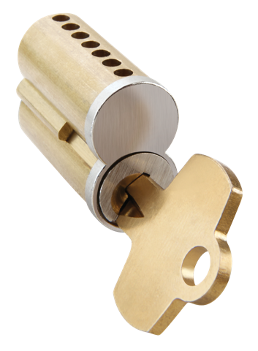
With a long-standing history, a fearless commitment to growth and an emphasis on branding in the global marketplace well before it was an accepted business practice, STANLEY has become a trusted worldwide name for hardware on the openings of today’s buildings. STANLEY continues to deliver innovative, high-quality products that have made the STANLEY name synonymous with the highest level of craftsmanship and dependability for more than 170 years. Simply Innovative. Simply STANLEY.

Slide 4
Stanley Door Hardware

Slide 5
STANLEY products are designed to fit a variety of commercial applications, from mixed-use developments with retail shops and multifamily housing, to other commercial buildings, such as offices, retail outlets and assisted living facilities. With superior design, uncompromised materials and one of the industry’s best lead times, it is no wonder that more customers and professionals trust STANLEY than any other brand.

Slide 6
A COMPLETE DOOR OPENING SOLUTION Backed by a rich heritage of expertise and innovation, STANLEY offers an all-inclusive portfolio of products designed to work together as part of a complete security solution. Our mechanical locks, keys and cores, standard and narrow stile exit devices, hinges and door closers deliver quality you need at a price you can afford. Plus, with industry-best lead times and the ability to ship products from a single location, the STANLEY brand is certain to give you what you need—right when you need it.

Slide 7
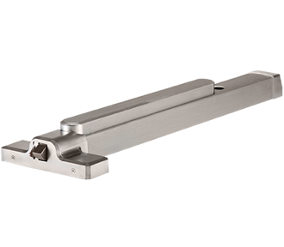
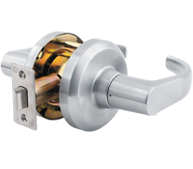
PRODUCTS FOR EVERY TYPE OF OPENING
Grade 1 Locks: Cylindrical, tubular, deadbolt, interconnected and mortise
Grade 2 Tubular Locksets: Mixed-use facility door hardware equipped with unique features like EasyPass™ and stylized rose options
Cores and Keys: Available in many keyways and a variety of finishes to fit your application
Grade 1 Closers: Full line of non-handed surface and concealed closers available in a variety of architectural finishes
Grade 1 Exit Devices: Available with features and finishes that complement your door hardware solution
Hinges: Constructed with durable bearings and high-quality materials for long-lasting, maintenance-free operation

Slide 8
Commercial Hardware: Reliable Security

Slide 9
Trusted Experts. Proven Reliability. Customers trust STANLEY’s history of proven performance and expertise. We never compromise on materials or craftsmanship, so we stand by the reliability and long-term durability of STANLEY Commercial Hardware products with limited lifetime mechanical warranties, as well as finish and electrical warranties you won’t find on comparable products.

Slide 10
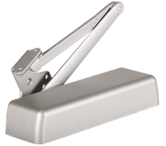
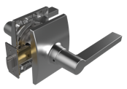
Products for every type of opening
Innovation At Your Fingertips
STANLEY Commercial Hardware drives innovation to make leading-edge security more accessible, easier to install and simpler to maintain. We’ve engineered breakthroughs that make our products easy to configure and install with non-handed, field-reversible and field-sizeable options, easy-to-follow instructions and unique packaging designed to reduce installation time.
Industry-leading Availability
STANLEY Commercial Hardware offers one of the industry’s best lead times, with most products available to ship same day or next day. You can rely on STANLEY Commercial Hardware for in-stock, on-time security.
STANLEY Commercial Hardware proudly represents the high standards of the name your customers know and trust.

Slide 11
Commercial Hardware Locks Our locks are engineered for long-lasting performance. STANLEY Commercial Hardware Grade 1 and Grade 2 locks—cylindrical, tubular, deadbolt, interconnect, and mortise—easily exceed industry standards for strength, durability, and tamper-resistance. Available in a variety of styles and finishes, our mechanical locks—with interchangeable cores and options for electrified functions—are easy to customize and configure in the field.

Slide 12
Lock Series Types
QCL100 and QCL200 Series: Heavy-duty and standard-duty cylindrical locks built to have an exceptionally reliable performance life
QTL200 Series: Standard-duty tubular locks that make installation and retrofitting simpler
QGT200 Series: Decorative tubular locks available in a variety of functions and equipped with EasyPass™ and stylized rose option
QDB100 and QDB200 Series: Heavy-duty and standard-duty deadbolts with solid forged housing for added strength and performance life

Slide 13
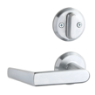
Lock Series Types
QCI200 Series: Standard-duty interconnect locks with single motion egress for easy emergency exit
QMS/QME100 Series: Heavy-duty mortise locks with standard security features at a better value

Slide 14
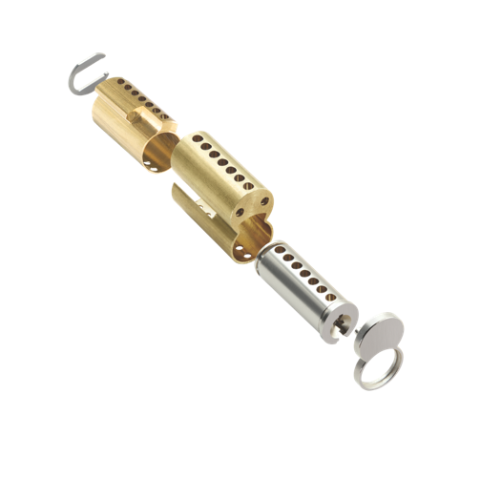
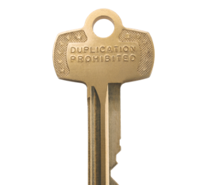
Cores and Keys: Strong Performance

Slide 15
Security, value and flexibility.
We designed STANLEY Commercial Hardware keying systems for compatibility with products from a variety of manufacturers.
More keyways: Up to 26 different keyways available
More standard finishes: Satin Brass, Oil-rubbed Bronze, Satin Chrome

Slide 16
Cores and Keys
The breadth of our keyway options makes it easy to find keys and cores that fit your application. And with a variety of standard finishes and quality materials that make our products long-lasting and more secure, you’ll not only enjoy a great value—but also more peace of mind.
With more options, short lead times, simple installation and reliable performance, STANLEY Commercial Hardware cores and keys deliver the durable security you expect from the name more Americans trust for security products.

Slide 17
Core Options
7CS
Brass body with zinc face in 3 finishes
6- and 7-pin configurations
Uncombinated only; blank core face
26 available keyways
6CS
Brass body with zinc face in 3 finishes
6- and 7-pin configurations
Available combinated; multiple master key levels
BF-BEST “F” keyway
6EQ
Brass body with zinc face in 3 finishes
5- and 6-pin configurations; 4 core types
Available combinated or zero bitted; construction keying available
6 available keyways

Slide 18
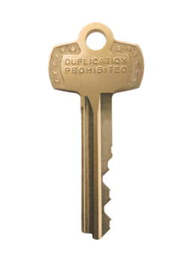
Key Options
7AS
Solid brass
Uncut; stamped "Duplication Prohibited" on front
6- and 7-pin configurations
26 available keyways
6AQ
Brass
Key serialization or do not duplicate (DND)
6- and 7-pin configurations
7 available keyways
6 key types

Slide 19
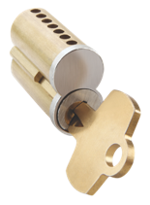
With 26 keyways available for new construction or retrofit, plus the craftsmanship you expect from the STANLEY name, our keyways offer greater security for your facility.
Standard Keyways
Complete line of 26 keyways • All brass keys • Keys stamped “duplication prohibited”

Slide 20
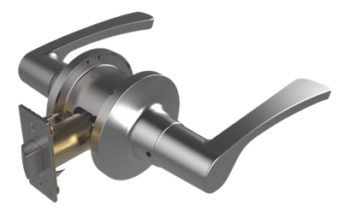
Grade 2 Tubular Locksets Stand Out with STANLEY

Slide 21
Grade 2 Tubular Locksets
STANLEY's new Grade 2 mechanical levers—with unique innovations like EasyPass™ and stylized rose options—are perfect for virtually every type of light commercial or mixed-use interior opening, including offices, student housing, hotels, healthcare facilities, military barracks and more.
Security: Durable, Grade 2 mechanical locks
Style: Available with stylized rose options and popular finishes for all locksets and deadbolts
Ease: EasyPass™ lever rotation for easy operation is not only more convenient, but has greater durability

Slide 22
Grade 2 Tubular Locksets
Lever Designs and Rose Options Make a statement right at the point of entry.
Mix-and-match Suite with other STANLEY products for a consistent look.
Ridge Lever Shown with Standard Rose
Echo Lever Shown with Decorative Rose
Tempo Lever Shown with Classic Rose
Standard
Decorative
Classic
Ridge Lever Shown with Standard Rose
Ridge Lever Shown with Decorative Rose

Slide 23
Commercial Hardware Door Closers
Designed for maximum flexibility and optimal operational performance, STANLEY Commercial Hardware door closers significantly exceed ANSI Grade 1 standards, are fully field-adjustable and can be used in a wide range of applications and climate conditions.
QDC100 Series Grade 1 Heavy-Duty Closer

Slide 24
QDC100 Series
We designed and engineered the STANLEY Commercial Hardware QDC100 Series with ultimate durability and versatility in mind. Built to provide the strength and versatility institutional and industrial markets demand, the QDC100 delivers lasting security for even the most rigorous applications. QDC200 (heavy duty) and QDC300 (standard duty) are also available.
ANSI/BHMA Grade 1 certified
Cast iron construction
Customization with retrofit-compatible features and an array of options

Slide 25
Commercial Hardware Exit Devices
With uncompromised materials and craftsmanship, our exit devices offer premium aesthetics and functionality. Performing well above ANSI Grade 1 certification requirements, STANLEY Commercial Hardware exit devices provide security you can rely on.
QED200 Series Grade 1 Heavy-Duty Narrow Stile Exit Device

Slide 26
Narrow Stile Exit Devices
Our narrow stile exit devices combine premium design features with the durability and reliability building codes and security plans require. QED100 (heavy duty wide stile) and QED300 (standard duty wide stile) are also available.
ANSI/BHMA 156.3 Grade 1 and ADA certified
Rim, surface vertical rod and concealed vertical rod with fire-rated options
Superior engineering for smooth and reliable functionality
Customizable and field-sizeable for quick and simple installation

Slide 27
Grade 1 Closers: Built to Last

Slide 28
Grade 1 Closers
STANLEY premium door closers offer a wide range of door control solutions that exceed today’s growing demand of architectural opening requirements.
Special R-14 silicon aluminum alloy construction
Non-handed surface and concealed closers for every type of opening
Available in a variety of architectural finishes
Full hydraulic checking and adjustable spring power
Forged arms and high-impact cover

Slide 29
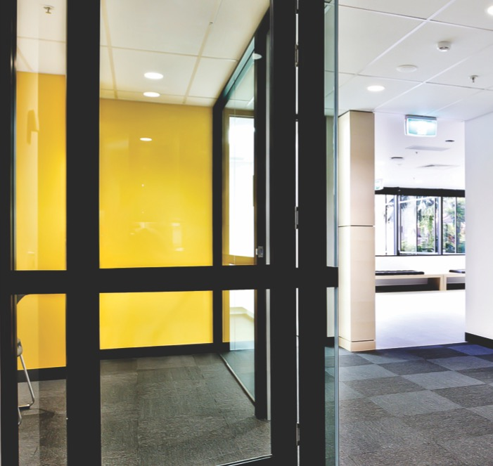
D-4550 Series
The STANLEY D-4550 Series is our best performing heavy-duty closer for institutional applications.
Non-handed cylinder body
R-14 silicon aluminum alloy construction for superior strength and durability
Available in a variety of standard and heavy-duty arm configurations to accommodate a broader range of application requirements

Slide 30
D-3550 Series
The D-3550 Series is STANLEY’S most versatile door closer.
Reduced body profile provides ease of installation
Automotive grade R-14 silicon alloy construction provides dependable performance

Slide 31
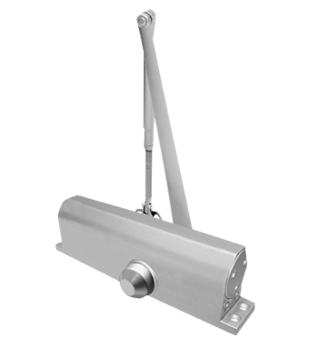
D-1610 Series
The D-1610 Series is a slim line closer for standard aluminum storefront applications.
Forged steel-constructed pinion and piston for reliable performance
Non-handed cylinder body with cast aluminum construction

Slide 32
Grade 1 Closer Features
Regular Arm
There are several arm and secure cover types designed to fit a variety of applications. Additionally, with an automotive grade aluminum construction and a wide range of spring power adjustments, STANLEY closers are durable and reliable for every type of application.
Arm Types: Regular, top jamb, parallel, track and heavy-duty
Cover Options: Metal—brass or stainless (D-4550 only) and plastic
Parallel Arm
Track Arm
Heavy-Duty Arm

Slide 33
Hinges: Smooth and Dependable

Slide 34
Hinges
A door’s safe and reliable operation depends on the smooth performance of the hinge system, particularly in high-traffic areas. All STANLEY hinges conform to ANSI/BHMA standards to get the job done in any application.
Full-mortise, half-mortise, half-surface and full-surface options
Wide range of sizes and finishes for any door or frame application
Package comes with fasteners and cardboard shims for quick installation
Constructed with durable bearings and high-quality materials for long-lasting, maintenance-free operation

Slide 35
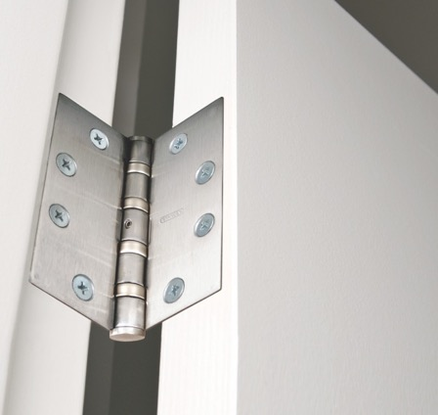
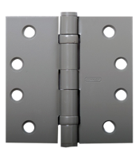
FBB Series
These hinges support the vertical load of the door, as the pin bearing on the inside of the hinge knuckles supports the lateral load of the door. These ball bearing hinges meet ANSI standards and are approved for use on fire-rated doors.
FBB SERIES

Slide 36
CB SERIES
CB Series These concealed bearing hinges are ideal for medium to heavy weight doors in high-usage applications. They are constructed with the patented LifeSpan® bearing and exceed ANSI/BHMA Grade 1 performance standards.
F Series These non-handed, plain bearing hinges are used on internal or external doors without door closers. They are available in full mortise, half mortise and half surface.
F SERIES

